Slide 1




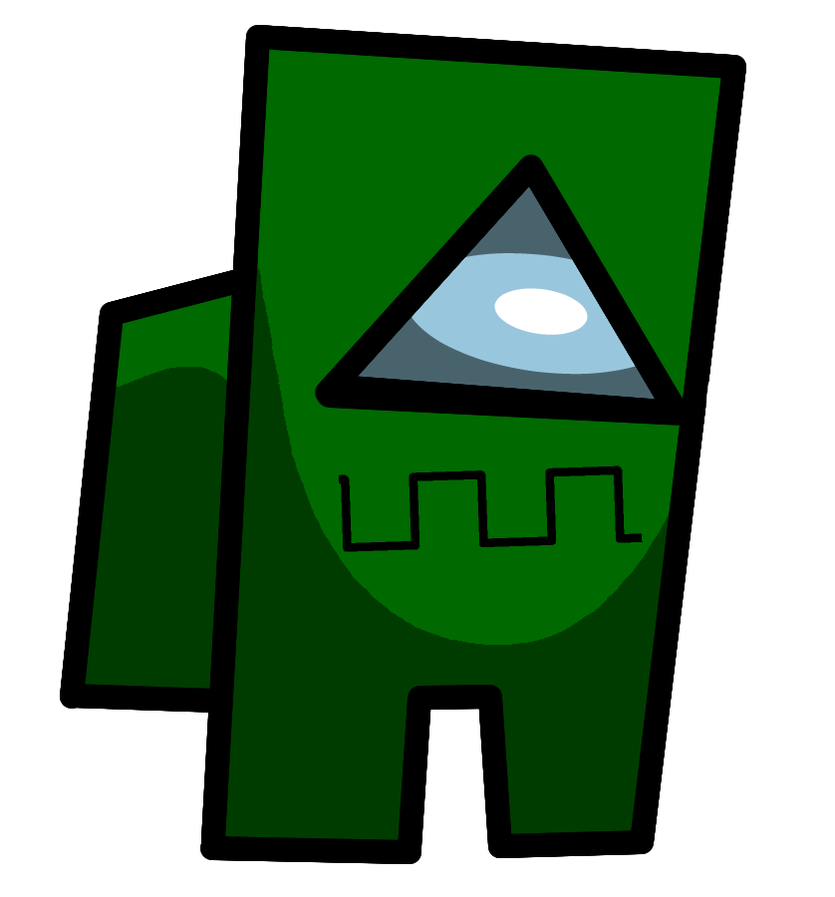



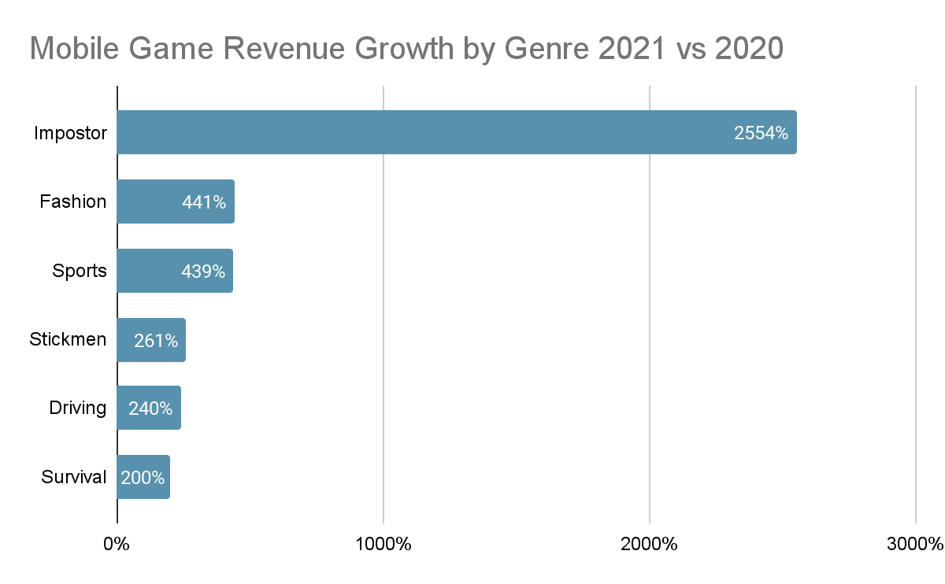
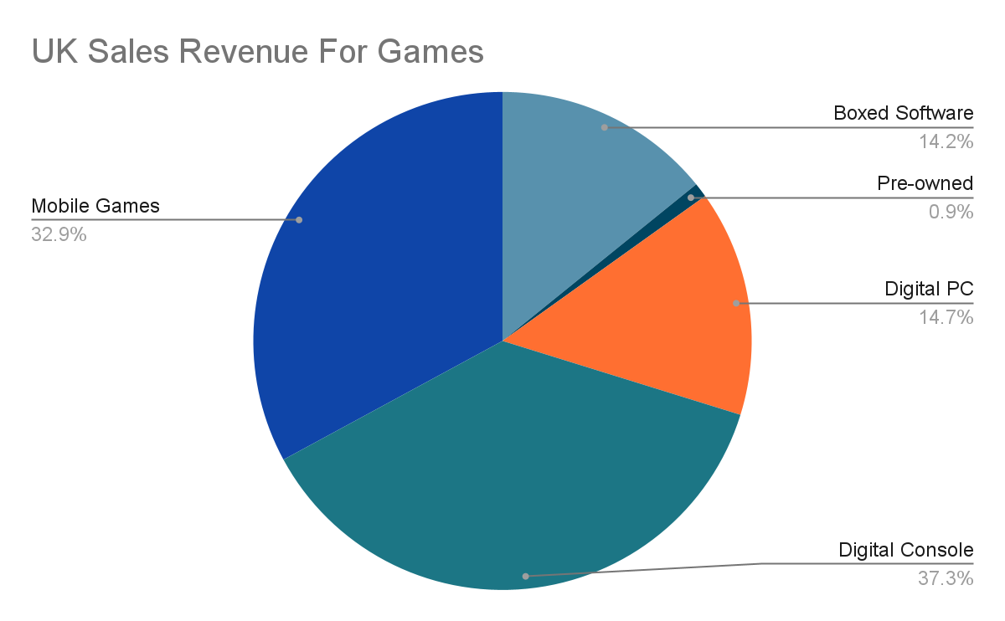
Impostor
Group 24 - Afnan, Iestynlee, Jack and Jakub
Complete tasks around campus!
Discover the different tasks scattered around campus, avoiding woe as you go!
Escape the imposters!
Not all of you are as you seem... Be careful who you trust
WIN!!!
And make new friends among the way!
Images from:Anne Freer, September 7, 2021. Businessofapps. Accessed On 24/03/2022. Available at:
https://www.businessofapps.com/news/among-us-accounts-for-94-of-player-spending-in-imposter-themed-mobile-games/
Already proven to be a hit!!!
Notes:
Screen shot(s) of the main interface(s) and annotated feature
Market research that supports the app design
Website and QR code if hosted publicly
- QR code can be generated here https://www.qr-code-generator.com/

